Slide 1
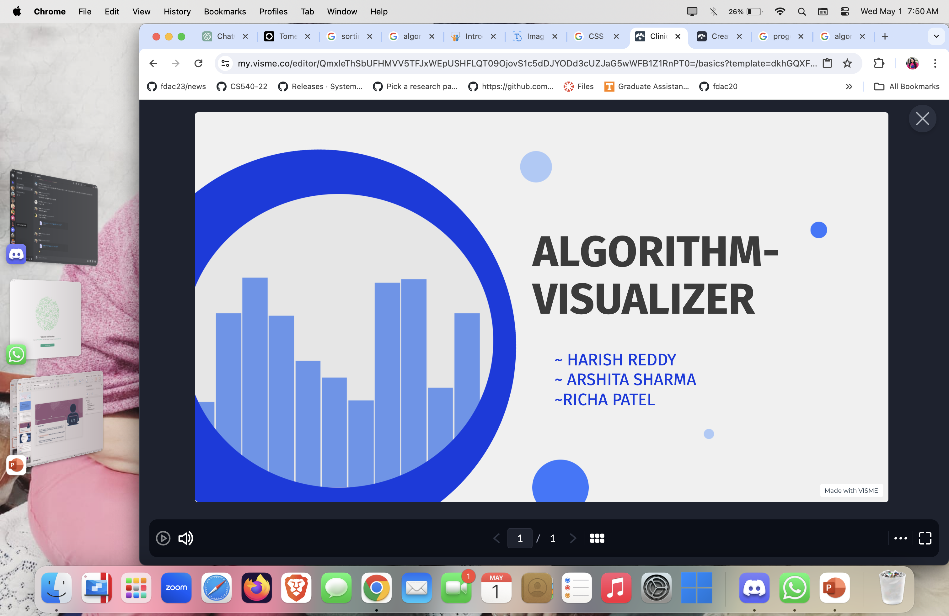


Slide 2
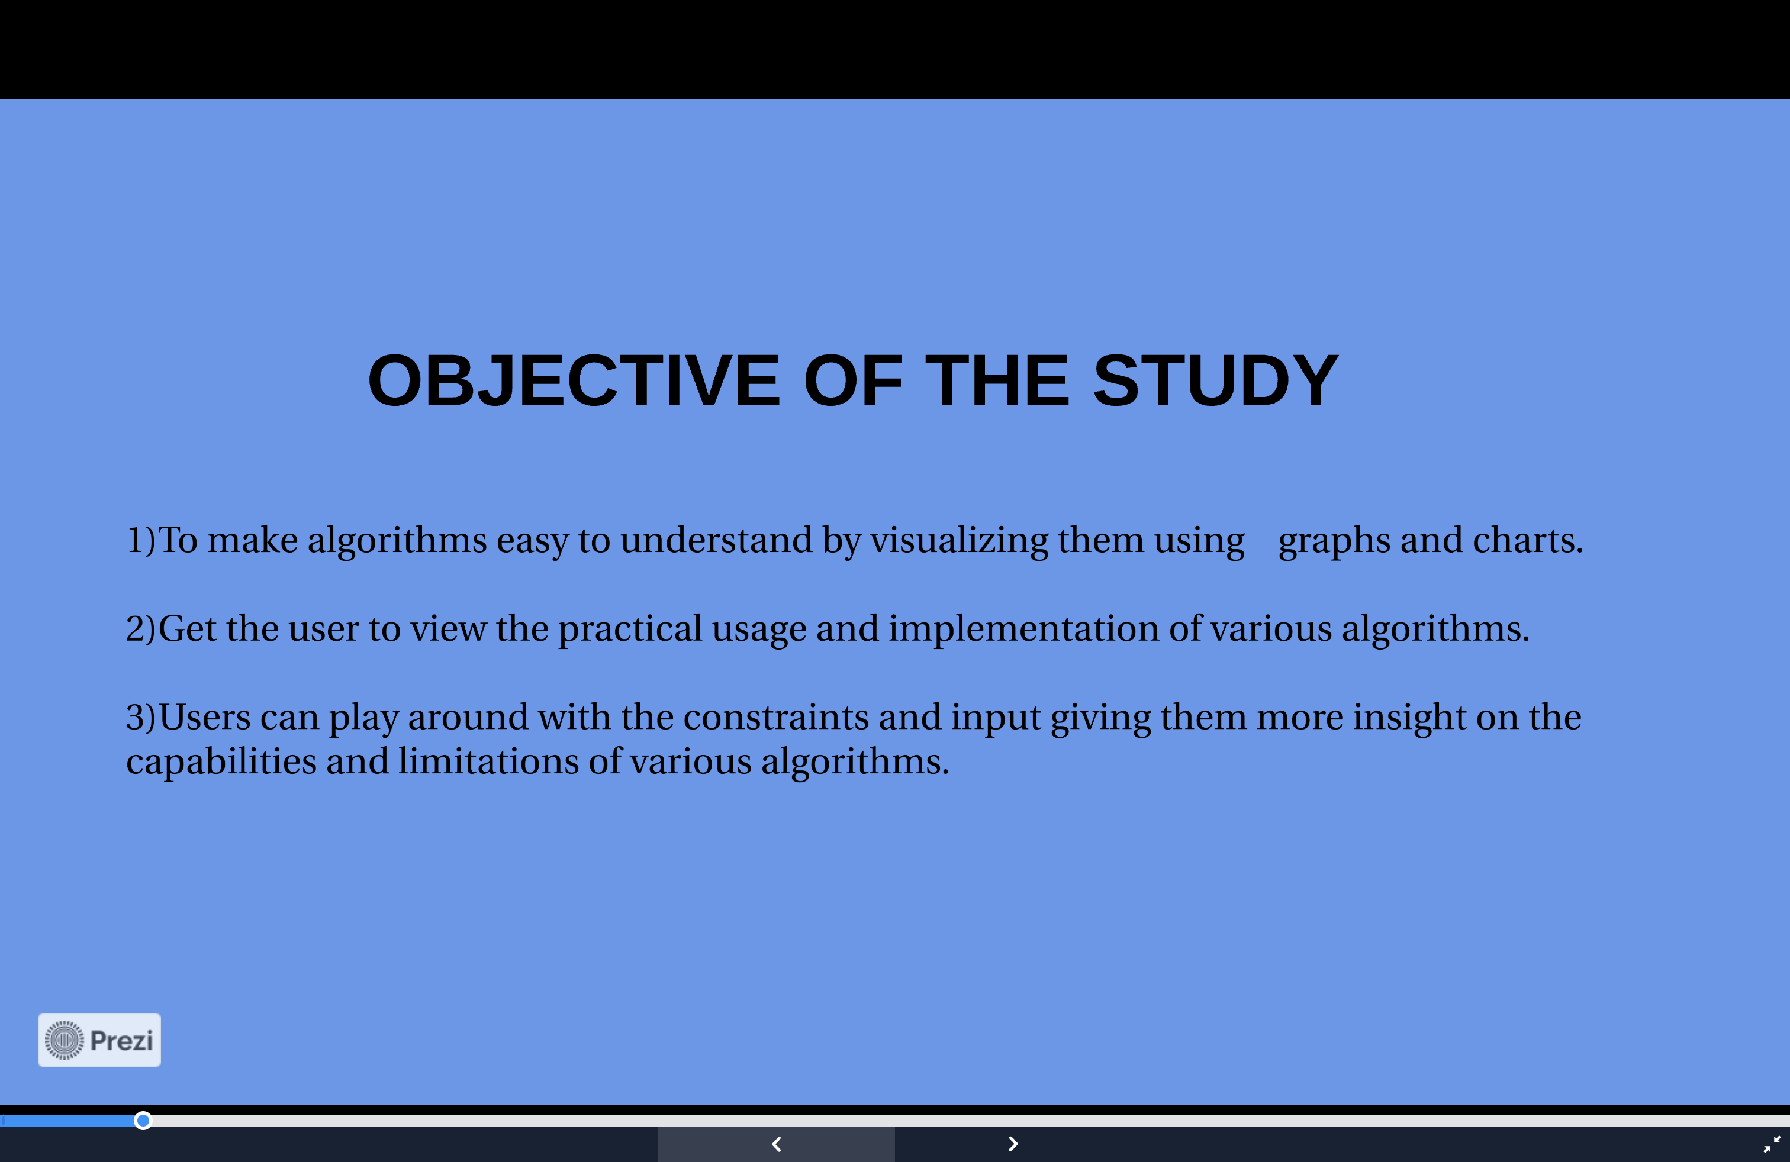

Slide 3
Overview:
Our software facilitates the easy learning of data structure algorithms. It offers several key advantages:
Visualization and Animation: Users can easily visualize and understand the types of sorting operations through detailed animations.
Clarity through Visual Aids: The use of clear images and diagrams aids in the effective comprehension of various algorithm concepts.
Interactive Learning: Users have the opportunity to apply each sorting algorithm to their data, maximizing learning benefits.
User-Friendly Interface: Designed for simplicity and ease of use, making it accessible to all users.
Ease of Use: The interface is straightforward, allowing for effortless operation.
Reduced Errors: The software minimizes errors, enhancing reliability.
Purpose of the Project: "Algorithm Visualization"

Slide 4
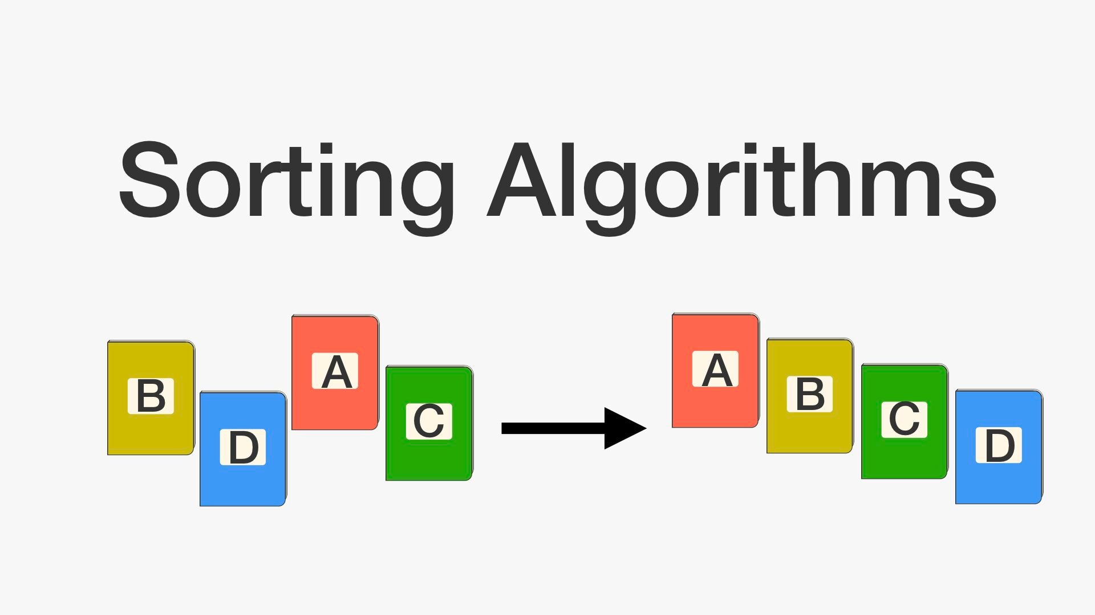
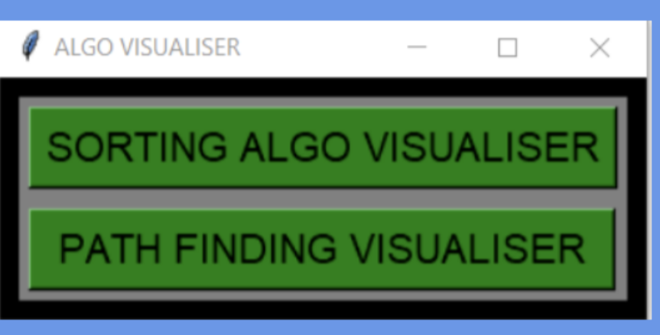
Background: Sorting algorithms are integral to computer science, forming a core part of algorithm and data structures knowledge.
Tool Highlight: Algorithm Visualizer
An interactive online platform that visualizes algorithms directly from code.
Enhances learning by allowing users to see the algorithm in action.
Benefits of Algorithm Visualization:
Provides visual context, making it easier to understand complex information.
Improves comprehension by showing trends, patterns, and outliers within data sets.

Slide 5
1) Sorting Visualizer :
The Sorting Visualizer is the interface through which the user can interact and Visualize with various sorting algorithms present . Currently the following sorting Techniques can be visualized using this interface: a) Bubble Sort b) Insertion Sort
c) Quick Sort
d) Selection Sort
~This interface provides user with various control options and by the use of which the user can set constraints, test the algorithm to its limit and also provide their custom input to the interface for visualization.

Slide 6
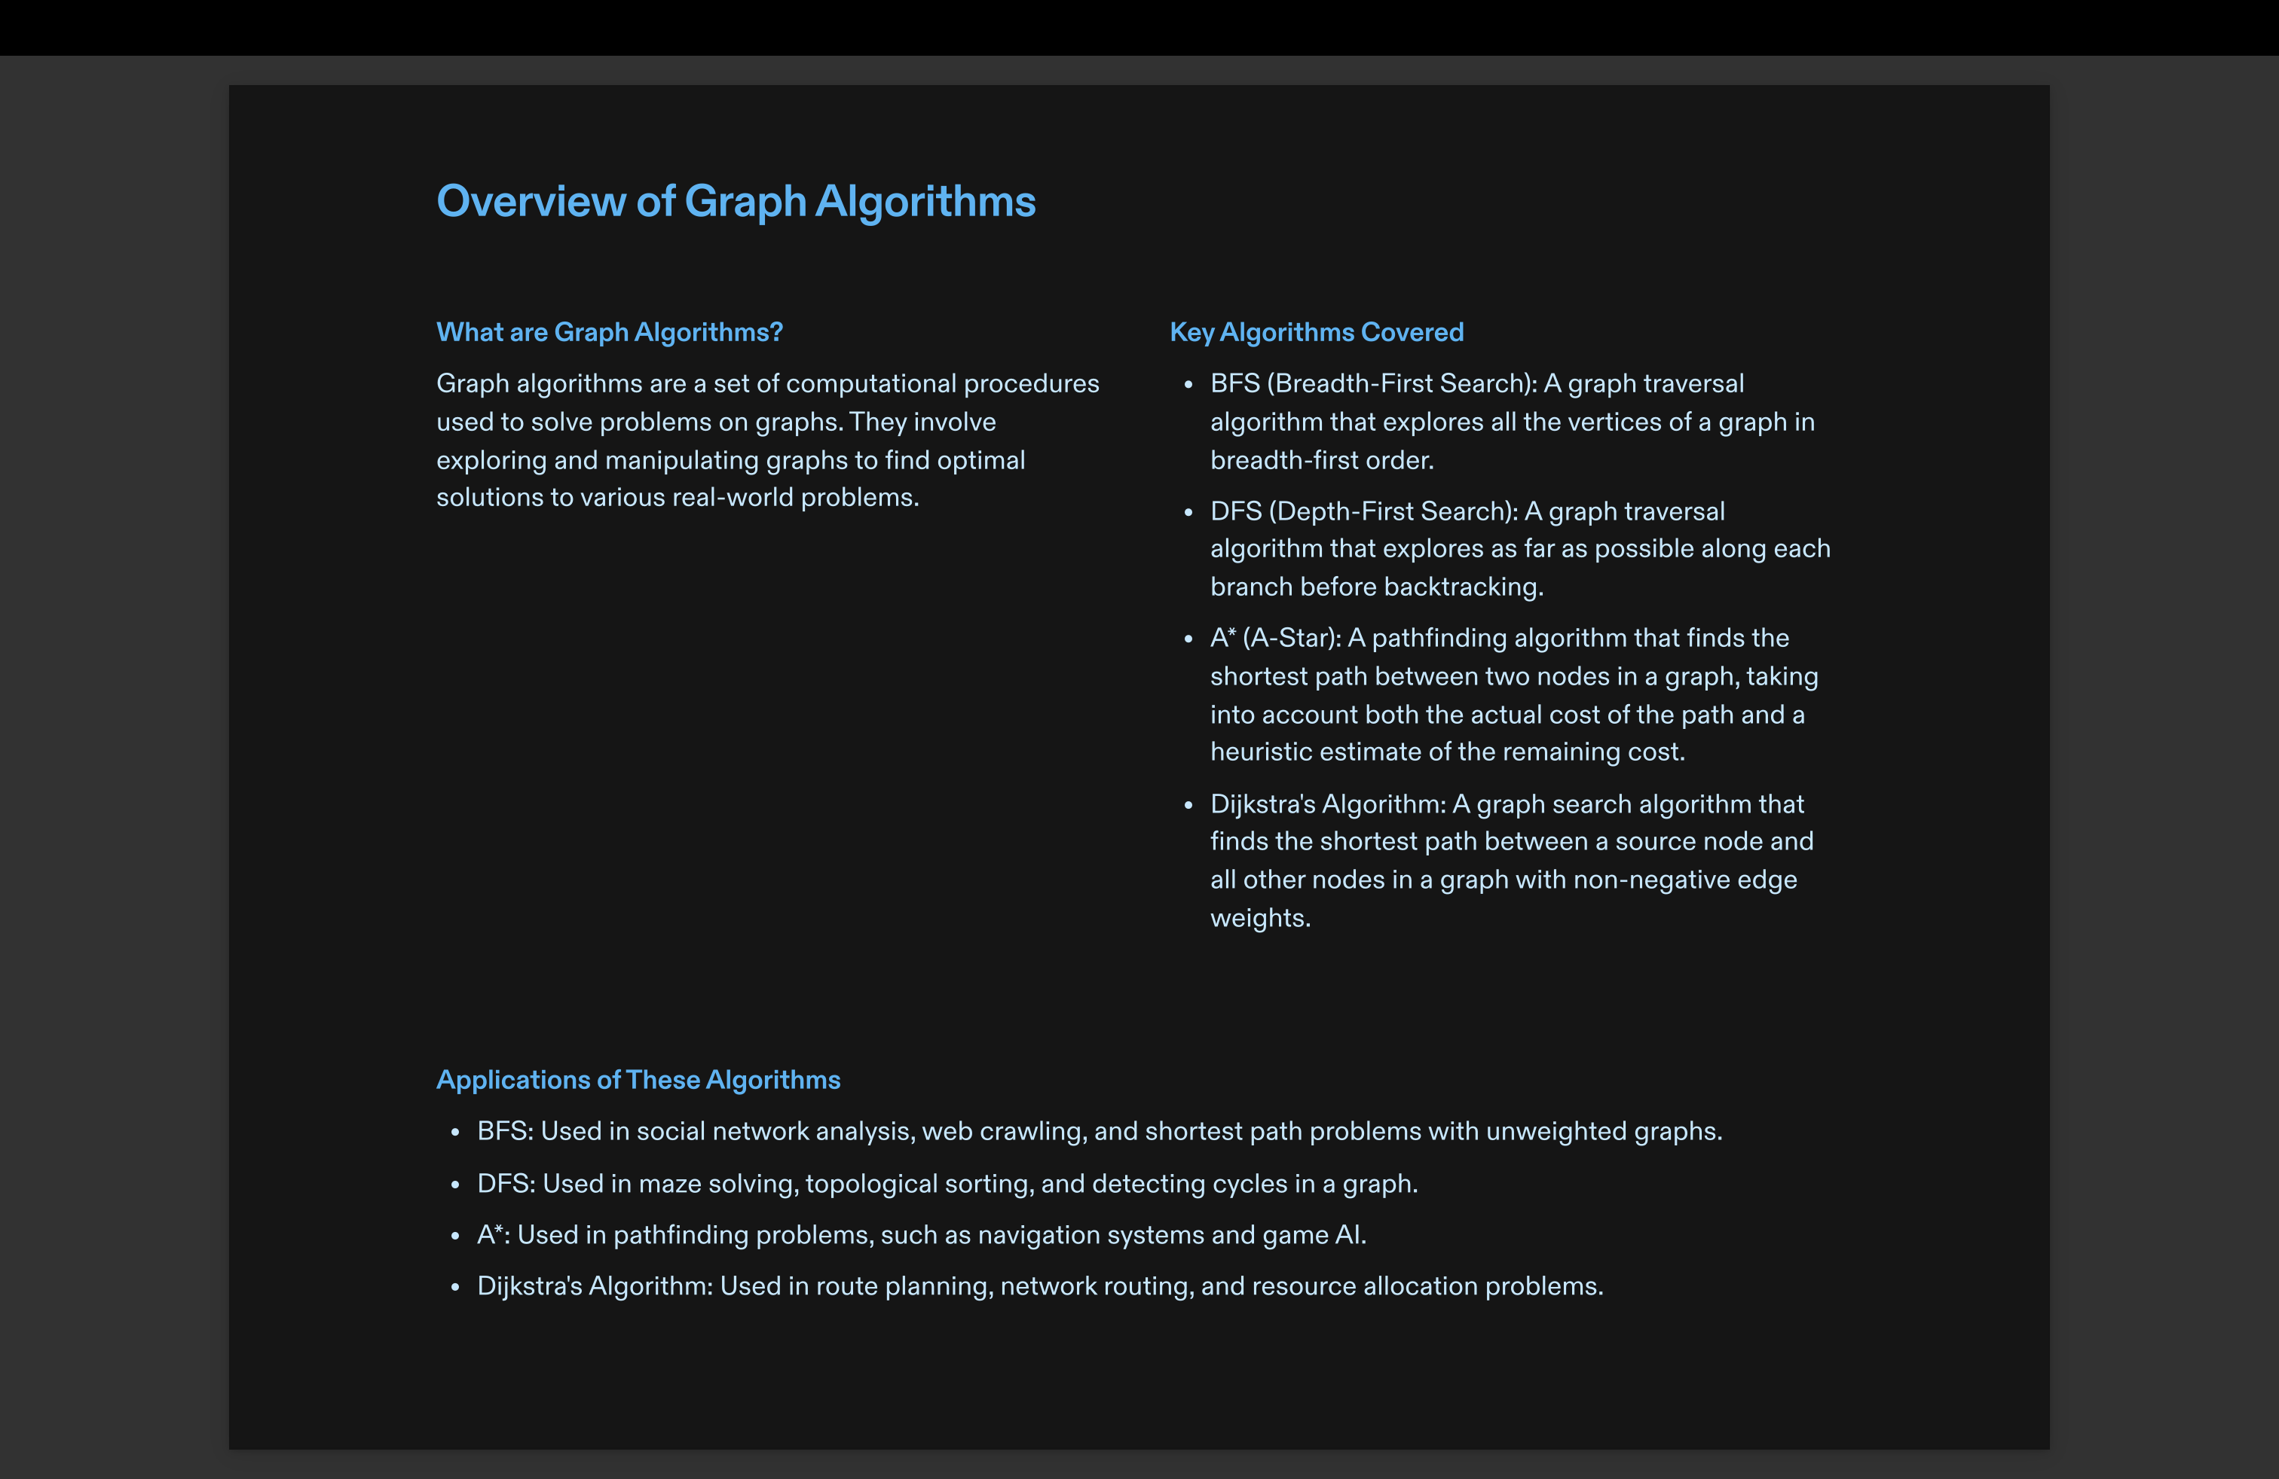

Slide 7
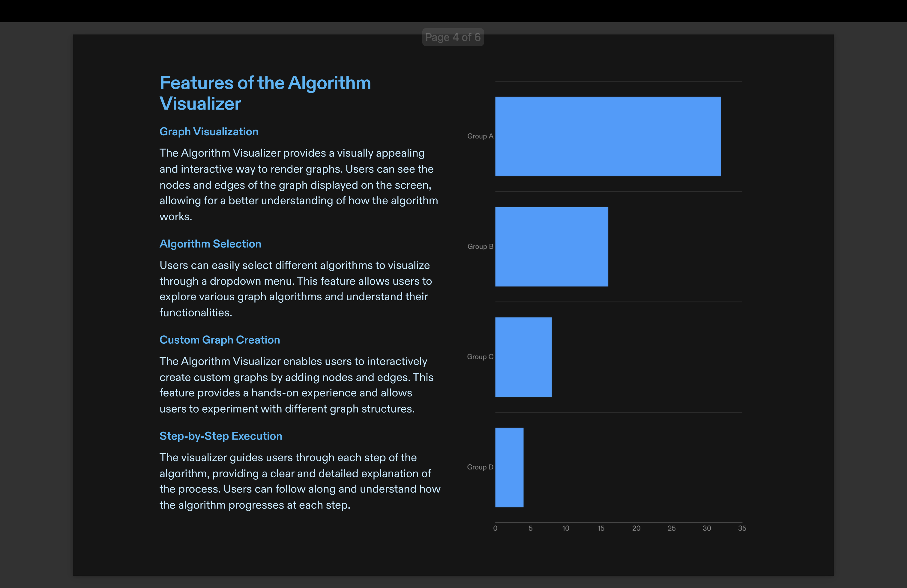

Slide 8
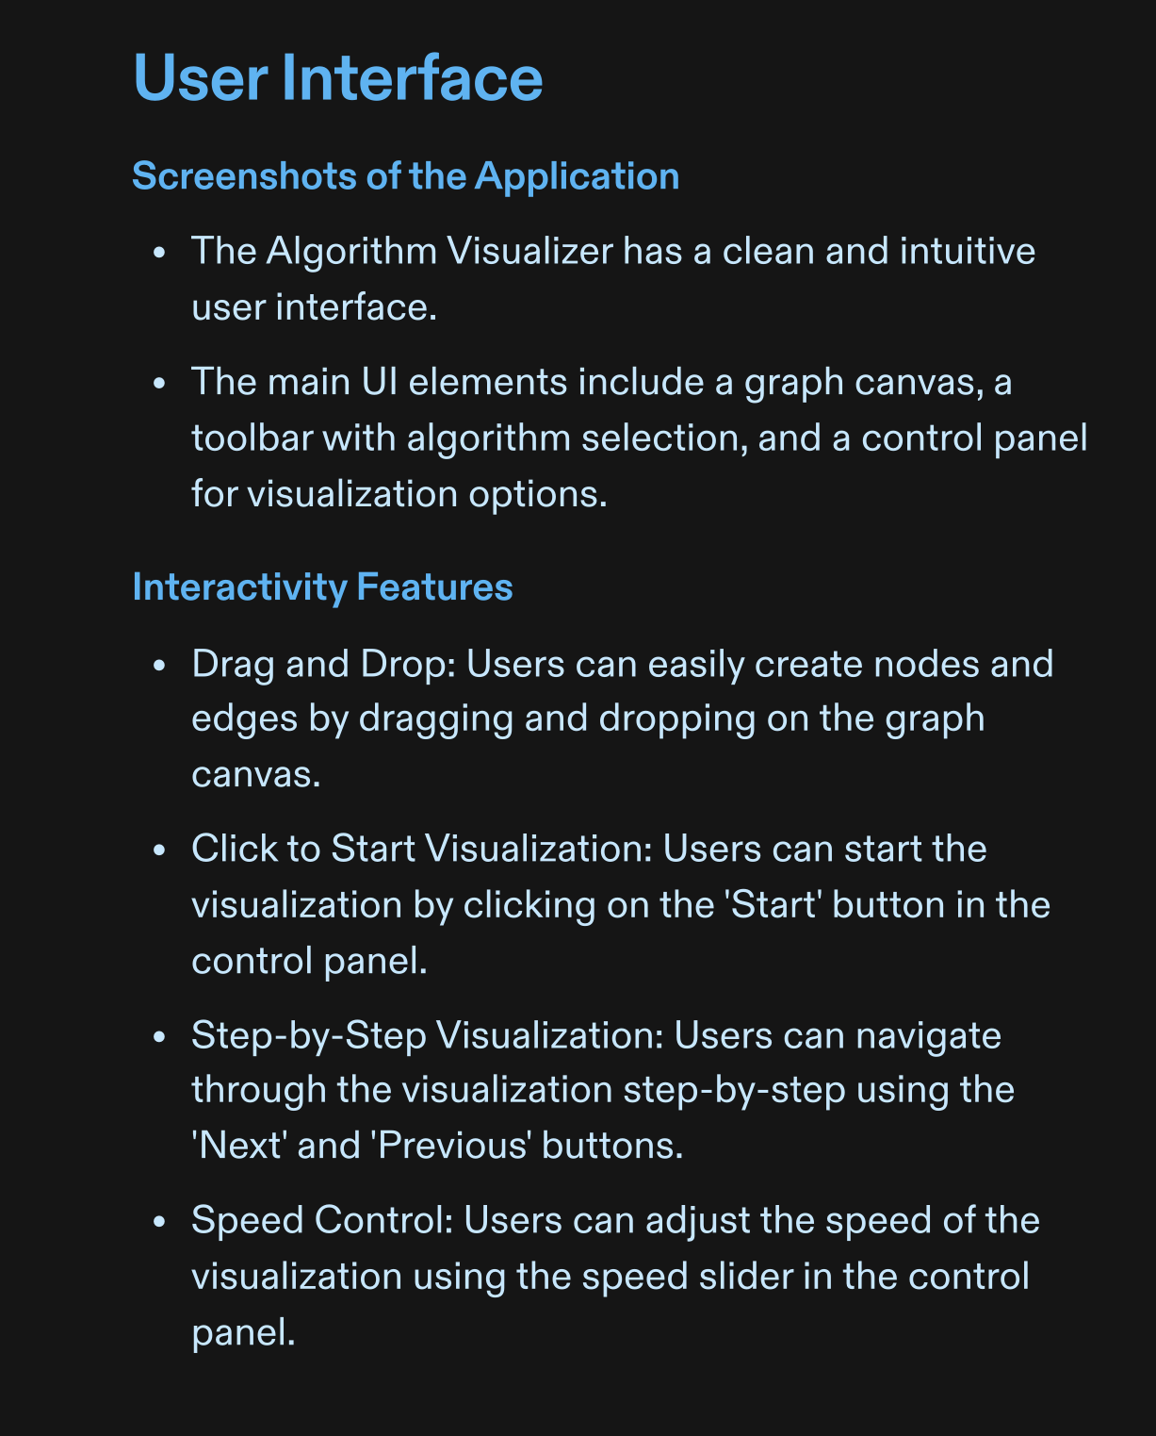
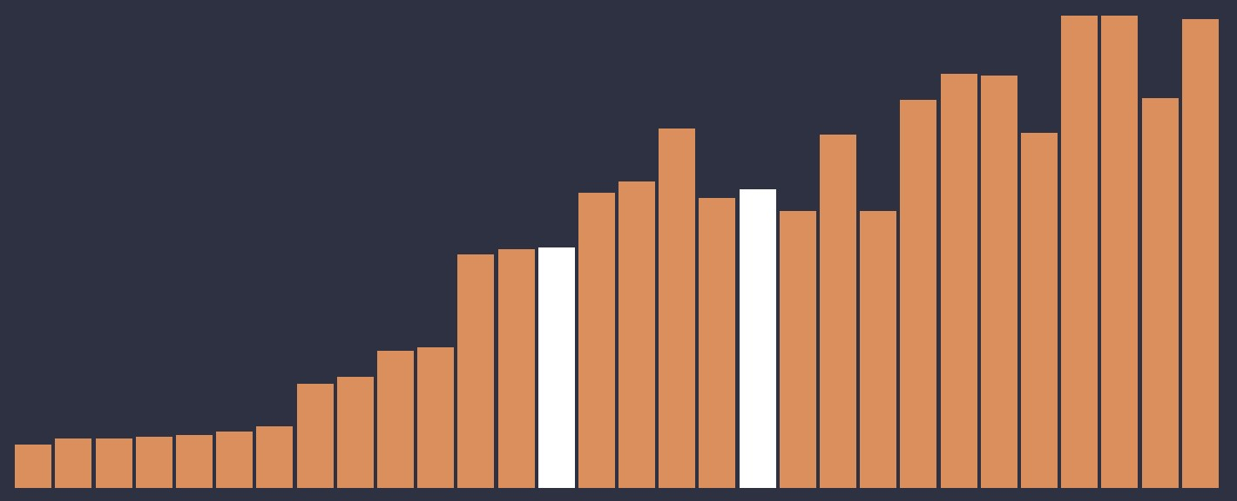
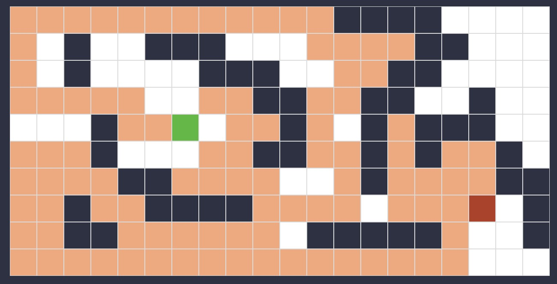

Slide 9

Key Features:
Graphical representation of algorithms in action.
Aids in simplifying and deepening understanding of algorithm operations.
Educational Impact:
Proposes enriching standard teaching methods with visualization tools.
Shares insights from practical experiences and future possibilities for teaching enhancements

Slide 10






Preferred Technologies
Languages
REACT SASS
JAVASCRIPT HTML CSS

Slide 11

(Syntactically Awesome StyleSheets)

Slide 12
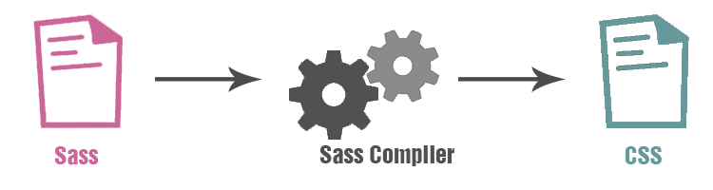
What is SASS
SASS stand for (Syntactically Awesome StyleSheets)
A scripting language that extends CSS by allowing developers to write code in one language and then compile it into CSS. Some examples of CSS preprocessor include: Sass, LESS and Stylus.
Sass allows you to use things like variables, nested rules, inline imports and more. It also helps to keep things organized and allows you to create stylesheets faster.

Slide 13
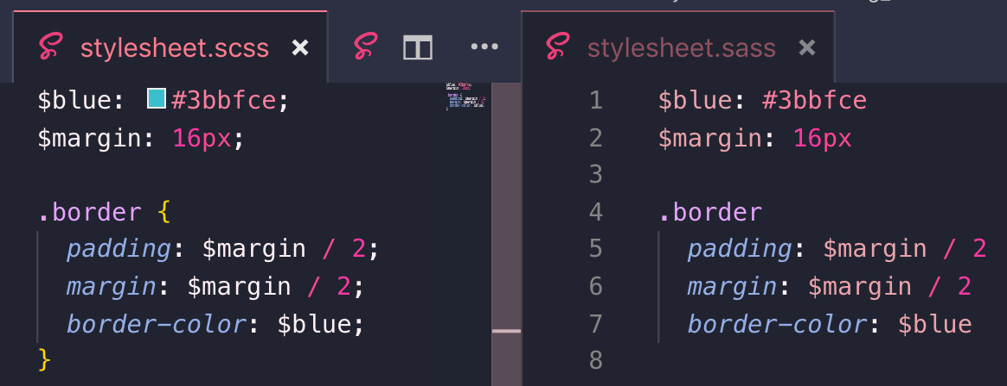
Syntax
Sass includes two syntax options:
SCSS (Sassy CSS): Uses the .scss file extension and is fully compliant with CSS syntax.
Indented (simply called 'Sass'): Uses .sass file extension and uses indentation rather than brackets; it is not fully compliant with CSS syntax, but it's quicker to write.

Slide 14

React

Slide 15
What is React.js?
A JavaScript library for building user interfaces.
Developed by Facebook
React is VIEW in MVC
Suitable for dynamic websites

Slide 16
Here are just few of the reason why people choose to program with react
Scalable
Large programs that display a lot of changing data are where react perform best
Modular
Instead of writing large, dense files of code,you can write many smaller,reusable file.React’s modularity can be a beautiful solution to javascript maintability problems
Fast
Apps are made in React can handle complex updates and still feel quick responsive
Flexible
You can use React for interesting projects that have nothing to do with making web apps
Popular
While this reason has admittedly little to do with reacts quality the truth is that understanding react will make you more employable

Slide 17
Who is using React?

Slide 18













Slide 19
Why React.js?

Slide 20
V(view) of MVC - Solution of View in MVC
Virtual DOM - Reactjs use the concept of virtual DOM which helps in the performance
Unidirectional Data Flow - Compare to the 2 way data binding. Reactjs use the concept of Unidirectional data flow which improve the over all performance.
UI Components - Reusable and interactive components
Coding is simpler because of JSX
Reactjs own debugger
React Native is going to be next big thing
Big minds are backing Reactjs

Slide 21



FUTURE SCOPE
Algorithm visualization can be seen as a valuable supporting tool, used in addition to standard ways of education in the field of computer science.
Algorithm visualization may help uncover some unknown features of algorithms.
Nothing is best than becoming able to communicate insights in real-time using immersive visuals.

Slide 22
